Slide 1
How to identify Approaches
Paper 3
A Level History
By Olivia Shore

Slide 2
To Begin
Maybe you’re viewing this tool at the beginning of Paper 3 and want more information, or you’re viewing this right before the AICE Exam....

Slide 3
To Begin
Either way, you’ll get a quick rundown of what Dr. Crihfield means when she talks about APPROACHES and HOW to correctly identify them!

Slide 4
The Basics
There are FOUR basic approaches that can be used…
Intentionalist
Functionalist
Structuralist
Synthesis

Slide 5
Not so Basic
There are some other possibilities you need to remember…
No Approach
Other reasons
OR
Top Down
Bottom Up

Slide 6

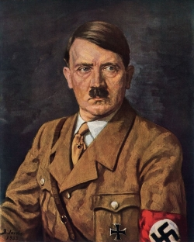
Intentionalism
C
This Photo by Unknown Author is licensed under CC BY

Slide 7

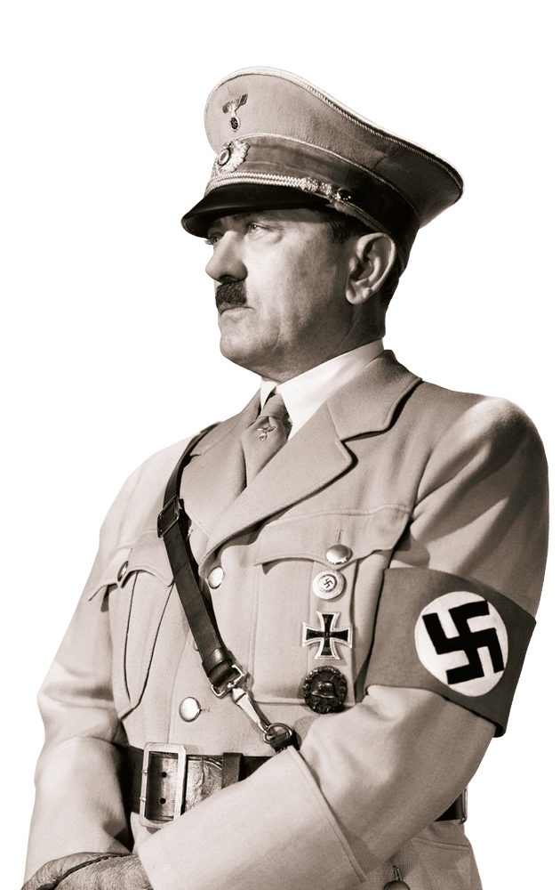
Intentionalism
All fingers point to Hitler!
The paper identifies Hitler as the ‘judge, jury, and executioner’
References Hitler as leader and he INTENDED to kill the Jews
Hitler had a “blueprint” of how to carry out FINAL SOLUTION
The author stresses Hitlers CONSISTENCY and OPERATION

Slide 8
Intentionalism
KEY WORDS
JEWISH QUESTION
FUHRER
COMMANDER
DIRECT INVOLVEMENT
INTENDED
ANNIHILATION OF THE JEWS
OPERATION
MURDERED
‘FINAL SOLUTION’
GENOCIDAL PLAN
CONTROLLING
DICTATOR

Slide 9
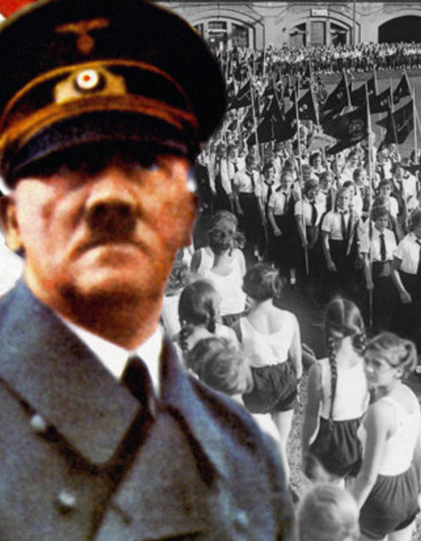
Functionalism
C

Slide 10
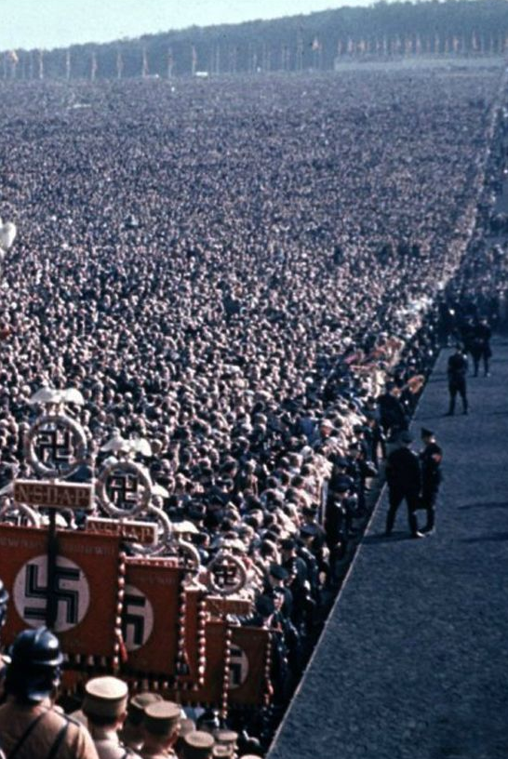
Functionalism
The ‘final solution’ evolved during the war
The situation of war caused Nazi Germany to fall to Hitler
The army and Hitler Youth influenced the German population into spreading false information about Jews
Came from lower ranks of German bureaucracy
Cumulative nationalism along with radical legislation
There was ‘no blueprint’
It was war conditions that fueled the killings

Slide 11
Functionalism
KEY WORDS
DISORGANIZED
PROCESS OF
RADICALIZATION
SEQUENCE OF
EVENTS
HITLER YOUTH
CONSTANT
IMPROVIZATION
COLLECTIVE
NATIONALISM
WAR TIME
ATTITUDE

Slide 12
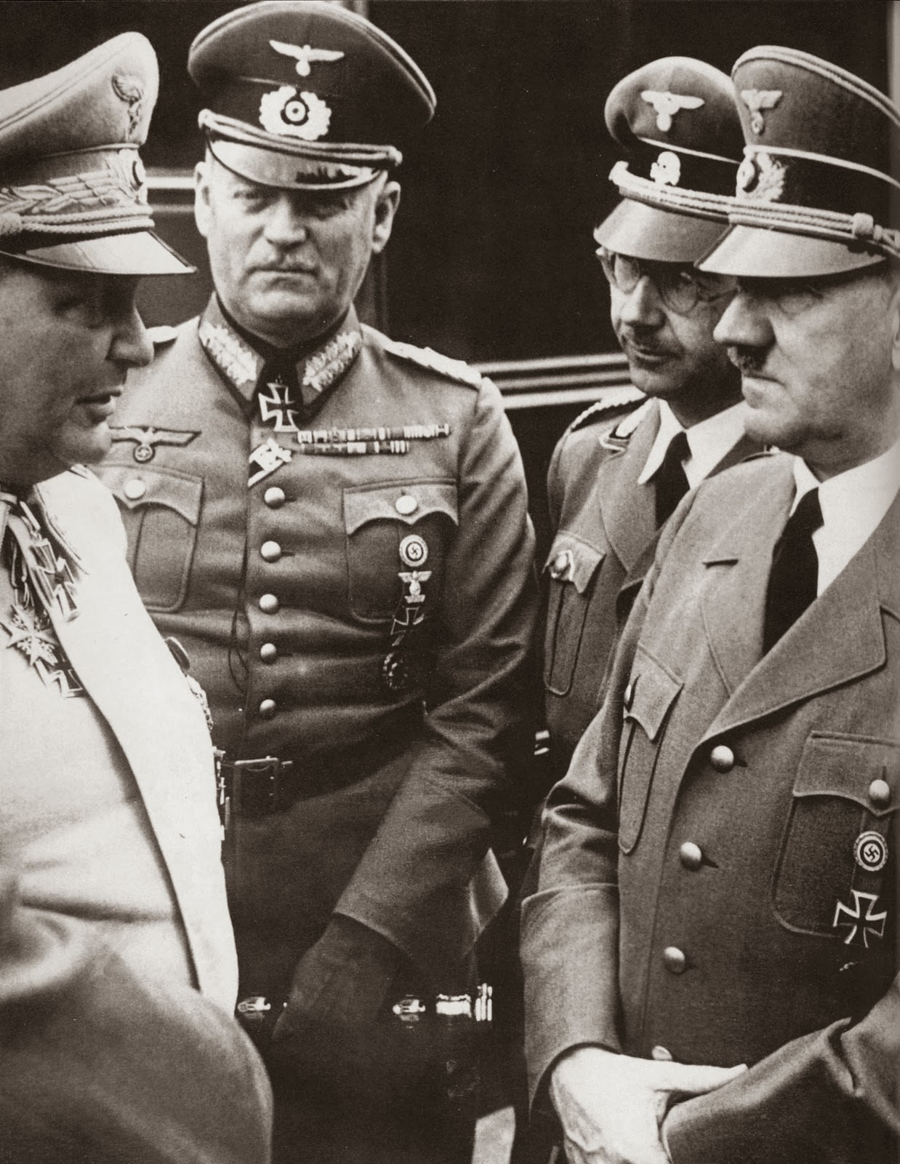
Structuralism
C

Slide 13
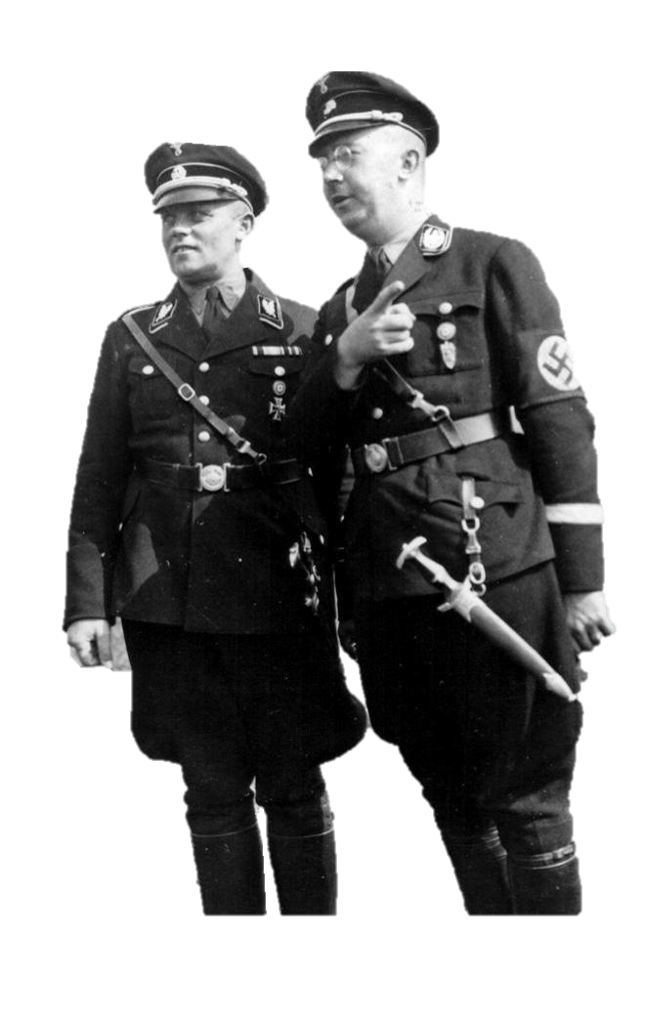
Structuralism
Top down approach
Relies on Hitler’s main men to carry out orders
Stresses the actions of Goebbels, Himmler, Goring, and Heydrich
Plan of annihilation
Who carried out the genocide
Discusses the importance of SS to carry out genocide
Political structure of Nazi Germany

Slide 14
Structuralism
KEY WORDS
DECISIONS WEREN’T MADE, BUT IMPLIED
ONGOING, RADICAL PROCESS
INITIALLY DID NOT INTEND TO KILL
POLITICAL MOTIVE
THE WILLINGNESS TO PLEASE HITLER
COMPETITIVE NATIONALISM
IMPROVISED SOLUTIONS
OTHER FACTORS, NOT HITLER
ESCALATED

Slide 15
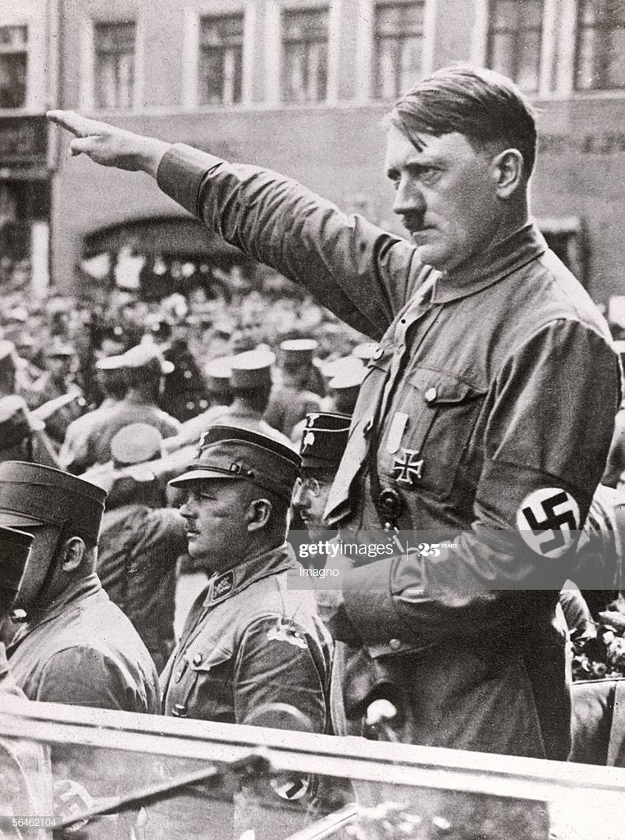
Synthesis
C

Slide 16
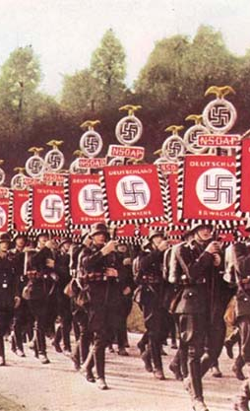
Synthesis
Combination of the previous approaches
Intentionalist and Functionalist
To understand how social and political structures of the Third Reich were motivated by ideological agenda
Cumulative radicalization
Acting in unison to achieve the antisemitic policy

Slide 17
Synthesis
KEY WORDS
VICTIMS
POLITICAL MOTIVE
WORKED TOGETHER
STRUCTURE FUNCTIONED UNDER HITLERS ORDERS
PERPETRATORS
BYSTANDERS
CULMINATION OF IDEAS AND MOTIVE
INTENT AND COMPETITION
NATIONAL SUPPORT

Slide 18
OTHER APPROACHES
No Approach
Other reasons
Top Down
Bottom Up

Slide 19

No Approach or
Other Reasons
C

Slide 20
No Approach
The author may not identify an approach!!
Instead, they’ll focus on an overarching topic and relate back to it throughout the passage
OTHER TOPICS
PERSECUTION OF HOMOSEXUALS
INTERNATIONAL RESPONSE
ROOTS OF ANTISEMITISM
VOLKISCH IDEALS
JEWISH
GHETTOS
ANTISEMITISM
PROPAGANDA

Slide 21
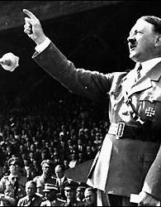
Top Down
C

Slide 22
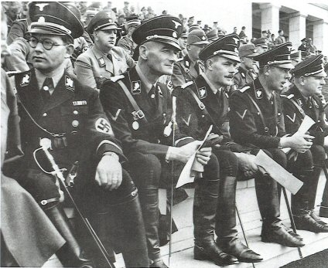
Top Down
Similar to Intentionalist
Following orders
Intent to obey orders from the political hierarchy
From Hitler, to his henchmen, to SS officers, to Luftwaffe, to the German Army
National to Local authorities
Establishing Gestapo

Slide 23
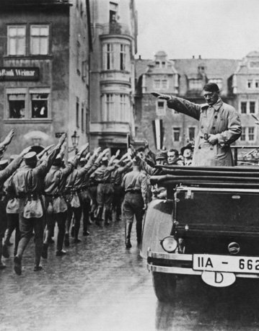
Bottom Up
C

Slide 24

Bottom Up
This perspective stresses the involvement of the German population in engaging in Anti-Semitic practices
Germans voting for Hitler and the New Reich
Isolating Jews and Non-Aryans
Avoiding contact with Jewish neighbors and friends
Camaraderie through excluding Jews
Sending their kids to Hitler Youth
Volkisch Movement

Slide 25
THE END!
I understand Paper 3 is difficult!
I hope this tool helps you with your studying. Don’t forget that the paper also needs a significant amount of background knowledge to support the claims the author makes.
                Good Luck!

